Slide 1

An Introduction to Statistics and Research Design
Chapter 1

Slide 2
Two Branches of Statistics
Descriptive statistics
Organize, summarize, and communicate numerical information
Inferential statistics
Use samples to draw conclusions about a population

Slide 3
Branches of Statistics
Descriptive: M = 80.2, SD = 4.5
Inferential: t(45) = 4.50, p = .02, d = .52
First describes the average score on the first test, second infers that this score is higher than a normal statistics average.

Slide 4
Samples and Populations
A population is a collection of all possible members of a defined group.
Could be any size
A sample is a set of observations drawn from a subset of the population of interest.
A portion of the population
Sample results are used to estimate the population.

Slide 5
Samples and Populations
A sample is a set of observations drawn from a subset of the population of interest.
A portion of the population
Sample results are used to estimate the population.

Slide 6
Samples and Populations
So, why would we use samples rather than test everyone?
What would be more accurate?
What would be more efficient?

Slide 7
Statistics = Numbers
Mostly, statistics is all about numbers.
So … how can we make these observations into numbers?
Think about all the different types of things you can measure…

Slide 8

Variables
Observations that can take on a range of values.
An example: Reaction time in the Stroop Task
The time to say the colors compared to the time to say the word

Slide 9
Stroop Demonstration
Look at the following words and say each word as quickly as you can:
http://www.youtube.com/watch?v=pP7xlattxTc

Slide 10
Stroop Test
Why is the Stroop test hard?
It seems we have a hard time inhibiting our reading of the word!

Slide 11
Types of Variables
Discrete
Variables that can only take on specific values (e.g., whole numbers)
How many letters are in your name?
Tricky part … we can assign discrete values to things we’d normally consider words.

Slide 12
Types of Variables
Continuous
Can take on a full range of values (usually decimals)
How tall are you?
What to do with those teacher evaluations?

Slide 13
More Classification of Variables
Nominal: category or name
Ordinal: ranking of data
These are generally considered discrete

Slide 14
More Classification of Variables
Interval: used with numbers that are equally spaced
Ratio: like interval, but has a meaningful 0 point
These are generally described as scale variables and are thought of as continuous.

Slide 15
Examples of Variables
Nominal: name of cookies
Ordinal: ranking of favorite cookies
Interval: temperature of cookies
Ratio: How many cookies are left?
What kind of data does our Stroop test give us? Interval or ratio?

Slide 16
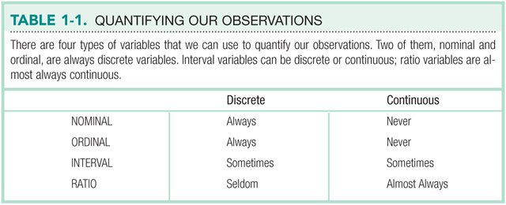

Slide 17
A distinction
The previous information talks about the type of number you have with your variable.
This type leads to the type of statistical test you should use.

Slide 18
Variables
Independent
That you manipulate or categorize
For a true experiment: must be manipulated – meaning you changed it
Generally these are dichotomous variables (nominal) like experimental group versus control group.
For quasi experiment: you used naturally occurring groups, like gender.
Still dichotomous

Slide 19
Variables
Dependent
The outcome information, what you measured in the study to find differences/changes based on the IV.
Generally, these are interval/ratio variables (t-tests, ANOVA, regression), but you can use nominal ones too (chi-square)

Slide 20
Variables
Confounding
Variables that systematically vary with the IV.
That you try to control or randomize away
Confounds your other measures!

Slide 21
Reliability and Validity
A reliable measure is consistent.
Measure your height today and then again tomorrow.
Standardized tests are supposed to be reliable.

Slide 22
Reliability and Validity
A valid measure is one that measures what it was intended to measure.
A measuring tape should accurately measure height.
A good variable is both reliable and valid.
How do we measure this?

Slide 23

Rorschach Personality Test
The reliability of the Rorschach inkblot test is questionable.
The validity of the information it produces is difficult to interpret.

Slide 24
Hypothesis Testing
The process of drawing conclusions about whether a relation between variables is supported or not supported by the evidence.

Slide 25
Assessing Variables
Back to … how do we assign numbers to things?
Called an operational definition.
This number assigning is important for using statistical programs, such as SPSS.
It likes numbers. ☺

Slide 26
Assessing Variables
Operational definition
How to measure or detect variable of interest
Depression:
Diminished interest in activities
Significant weight loss/gain
Fatigue (loss of energy)
Feelings of worthlessness
Recurrent thoughts of death or suicide

Slide 27
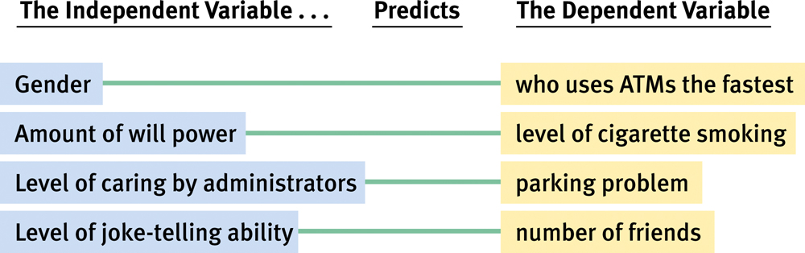
Developing Research Hypotheses

Slide 28
Types of Research Designs
Experiments: studies in which participants are randomly assigned to a condition or level of one or more independent variables

Slide 29
Experiments and Causality
Experiments: able to make causal statements
Control the confounding variables
Importance of randomization

Slide 30
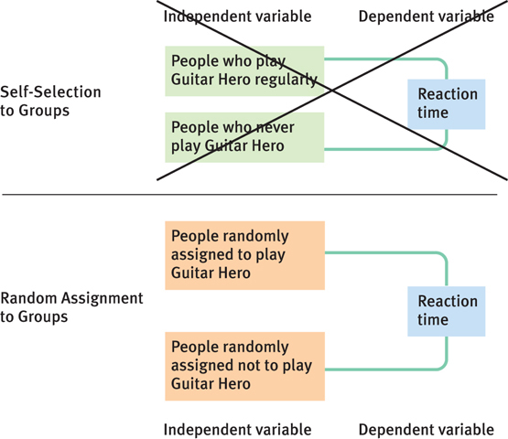
Figure 1-3:
Self-Selected into or Randomly Assigned to One of Two Groups: Guitar Hero Players vs. Non-Guitar Hero Players

Slide 31
One Goal, Two Strategies
Between-groups designs
Different people complete the tasks, and comparisons are made between groups.
Within-groups designs
The same participants do things more than once, and comparisons are made over time.

Slide 32
Other Research Designs
Not all research can be done through experimentation.
Unethical or impractical to randomly assign participants to conditions.
Correlational studies do not manipulate either variable.
Variables are assessed as they exist.

Slide 33
Correlational Analysis
Video game playing and aggression are related.
No evidence that playing video games causes aggression.

Slide 34
Outlier Analysis
An outlier is an extreme score - very high or very low compared to the rest of the scores.
Outlier analysis – study of the factors that influence the dependent variable.

Slide 35
Recap
Operational definitions – ways to assign numbers to variables that determine their scale (dichotomous/continuous)
Types of variables – describe how they were used in an experiment (IV/DV)
Types of research – further explain the workings of the IV/DV (exp/quasi/correl)
All of these are tied to an appropriate type of statistic.

